Slide 1
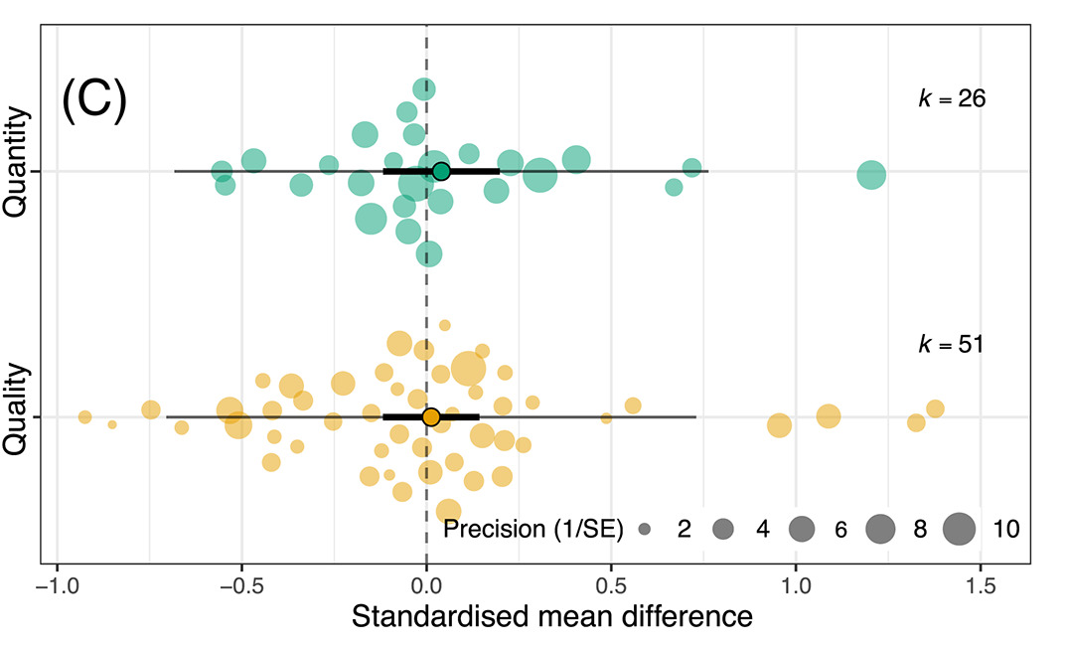
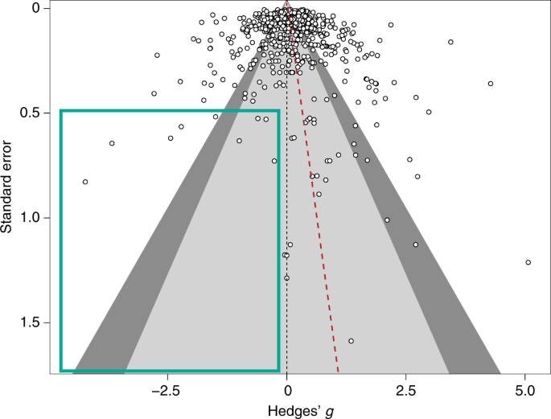
Meta-analysis in Comparative Physiology: A brief introduction to effect sizes and meta-analytic modelling
Nakagawa et al. 2021
De Boer et al. 2021
Daniel Noble, Nicholas Wu, Essie Rodgers, Patrice Pottier

Slide 2



Acknowledgements
Julia Koricheva
Wolfgang Viechtbauer
Shinichi Nakagawa

Slide 3
Workshop Overview
Part 1: 9:00 – 10:30
What is meta-analysis and why should we use it?
Effect size and sampling variance: the key data for meta-analysis
What are effect sizes?
What types are out there and when to use?
Standardizing effect estimates – nuisance heterogeneity
Interpreting effect sizes and transformations
Assumptions, limitations, and common challenges
Part 2: 11:00 – 12:30
Meta-analytic modelling
Fixed and random effect meta-analyses
Multi-level meta-analytic models (MLMA): The main types in comparative physiology
Non-independence – phylogeny, study, species, shared controls
Sensitivity analyses
Meta-regression and heterogeneity
Interpreting and reporting meta-analytic model output
Publication bias
Time-lag, reporting bias
Detecting and correcting
Part 3: 14:45 – 16:00
Help (advice) with your own meta-analysis! (if you need it)

Slide 4
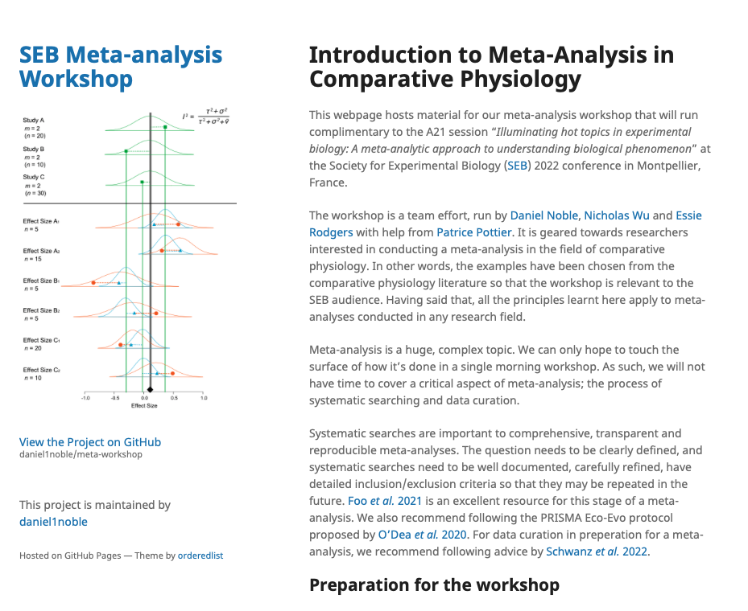
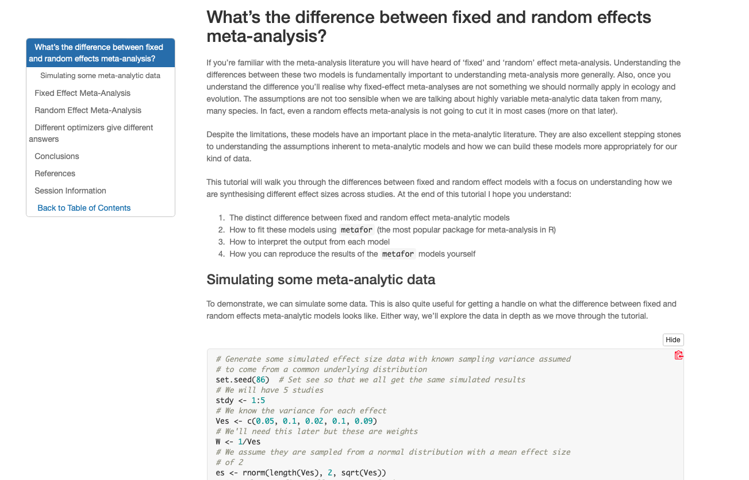
We have a webpage!
https://daniel1noble.github.io/meta-workshop/

Slide 5


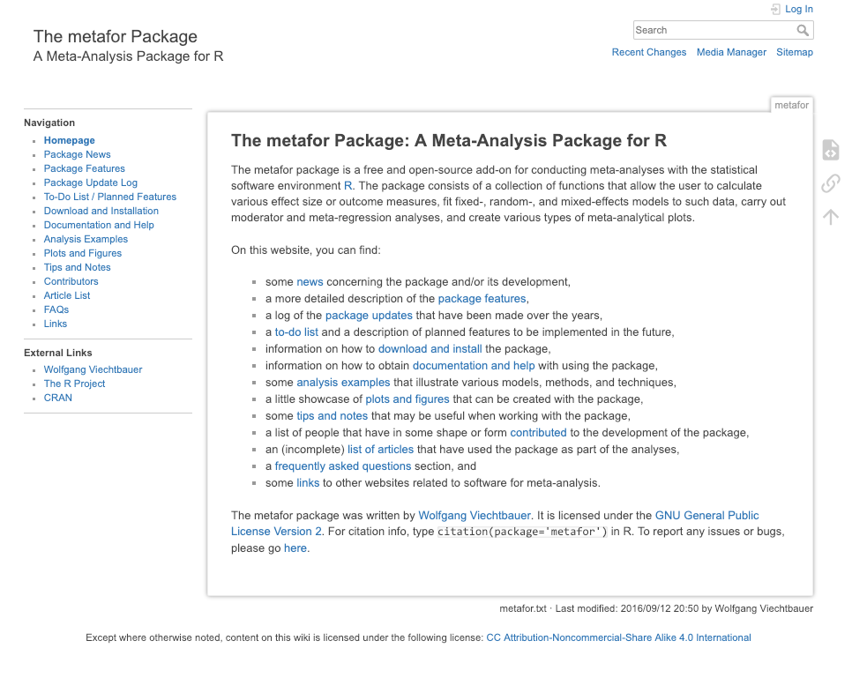
What we’ll use to code and analyze

Slide 6
https://wviechtb.github.io/metafor/articles/pkgdown/diagram.png

Slide 7
What is a meta-analysis?

